Slide 1

Family income as a predictor of educational attainment
Michelle Rice
DSC 680 Bellevue University

Slide 2
Educational Inequality
Definition: Unequal access to education and the unequal outcomes for students that result
Causes: government policies, school choice, family wealth, parenting style, implicit bias towards the race or ethnicity of the student, and the resources available to the student and their school

Slide 3
Family wealth in the United states
2019 Stats:
Median household income = $62,843
Age 0 – 17 in poverty = 18.52%
Age 0 – 17 in deep poverty = 8.16%
Notes:
Deep poverty = income 50 less than poverty threshold

Slide 4
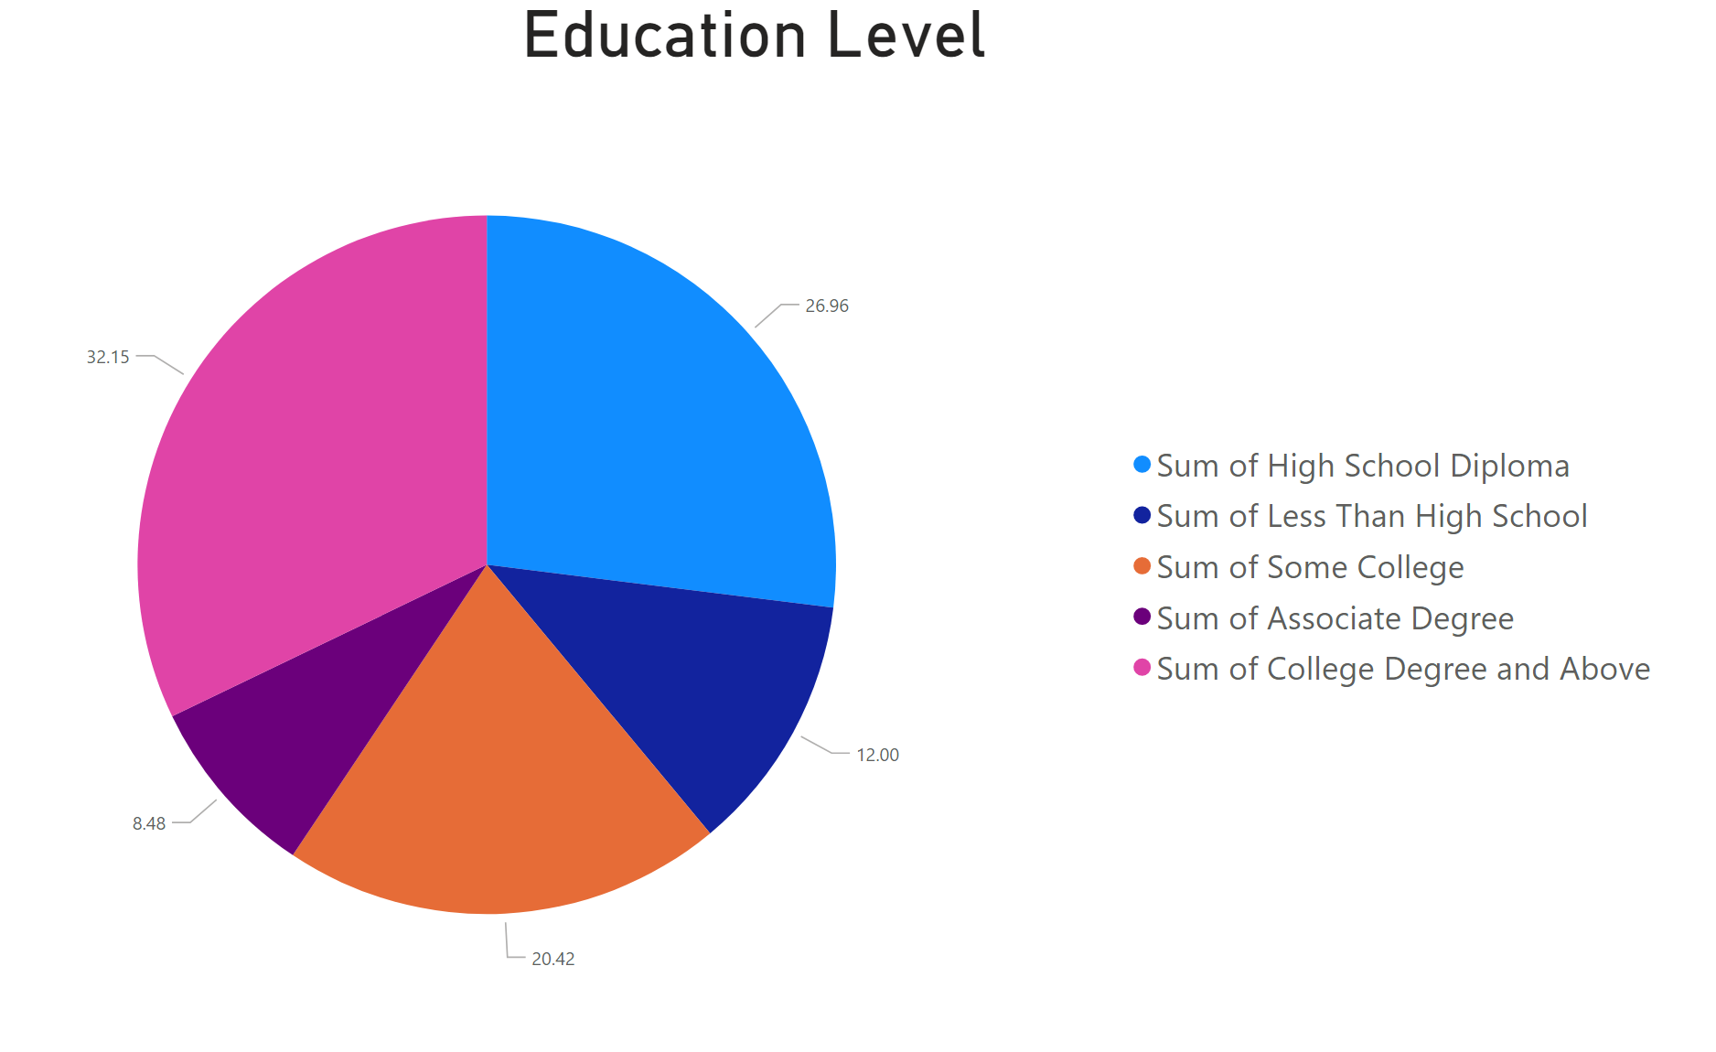
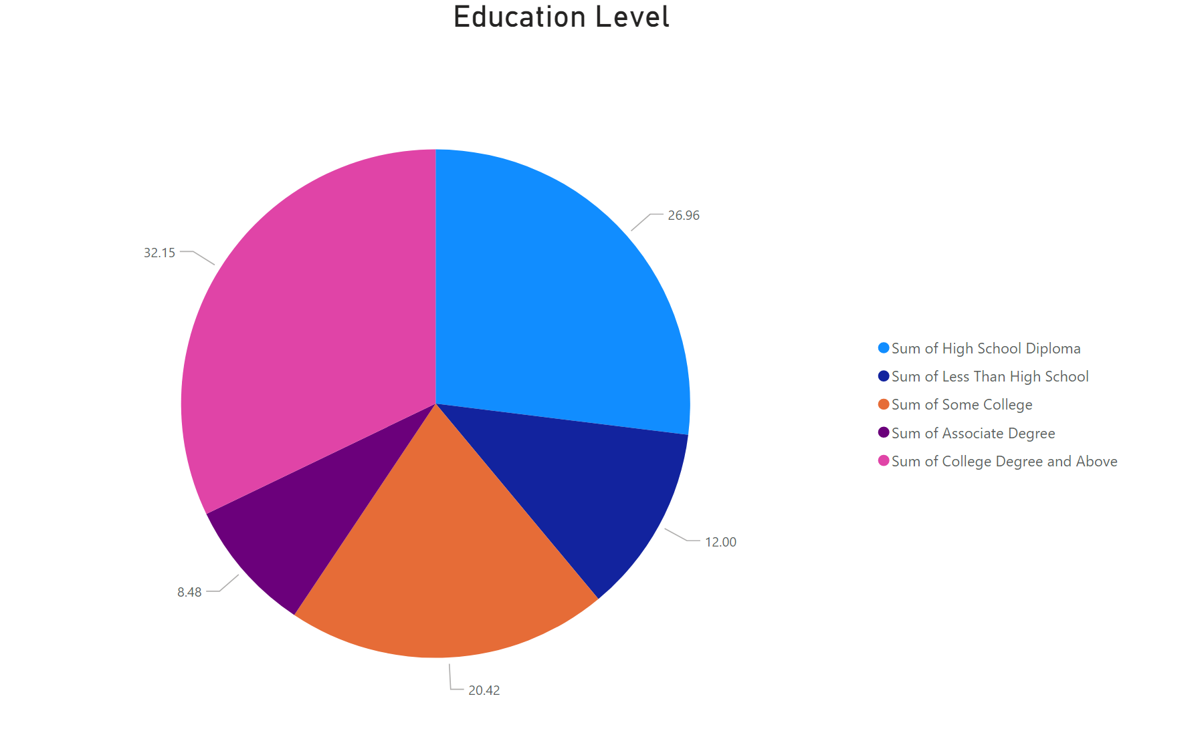
Education attainment in the united states
Notes:
Percentages:
Less than hs: 12
HS only: 27
Some College: 20
Associate:9
Degree: 32

Slide 5
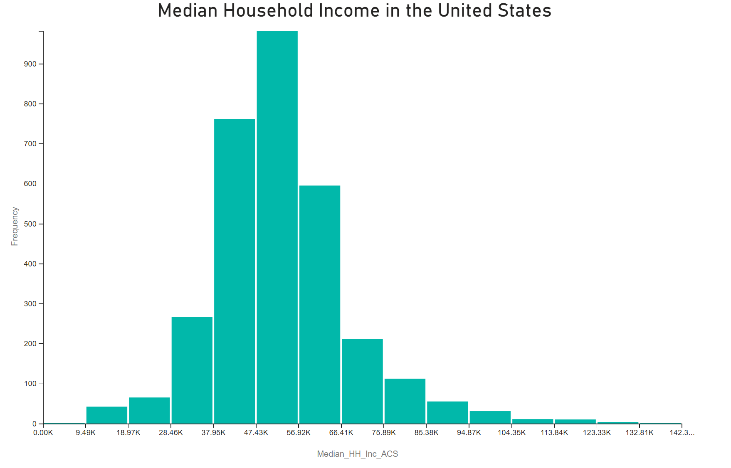
Median income in the united states
Median household income = $62,843

Slide 6
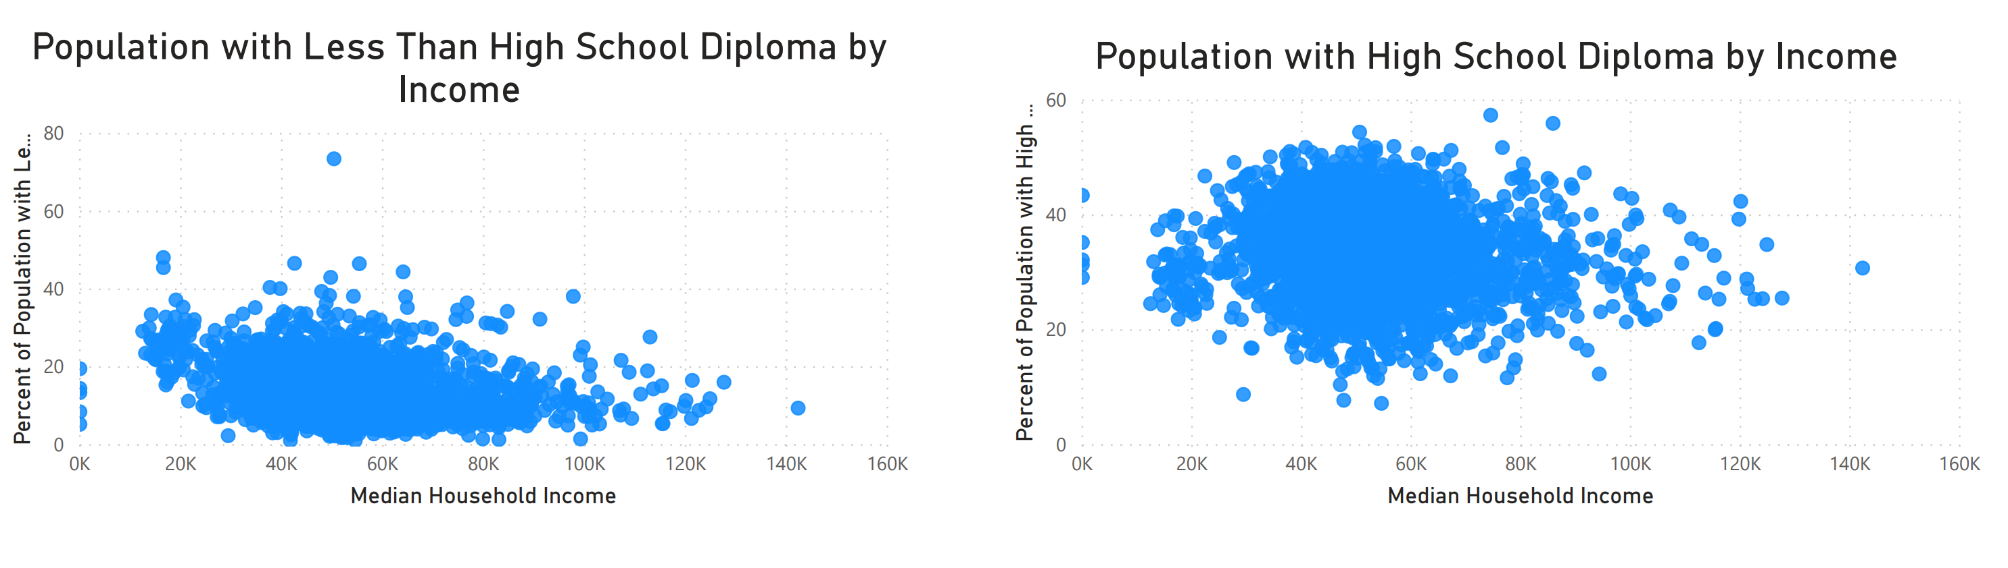
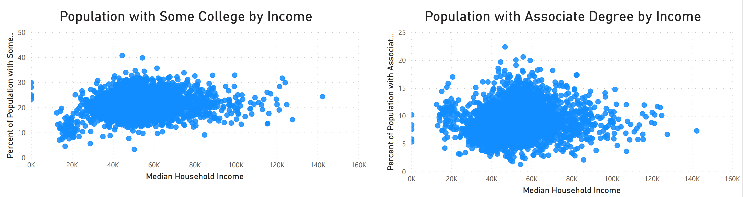
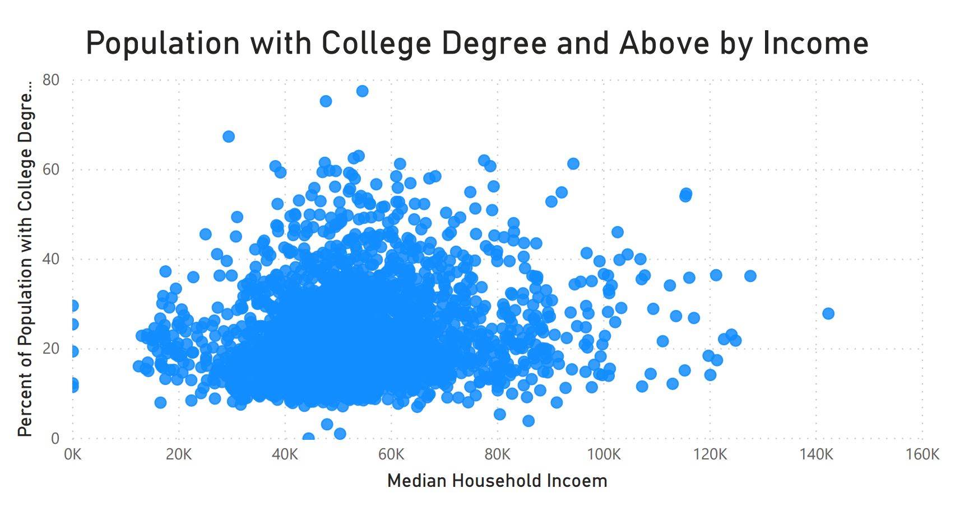
Educational attainment and Income, cont.
Notes:
Percentages:
Less than hs: 12
HS only: 27
Some College: 20
Associate:9
Degree: 32

Slide 7
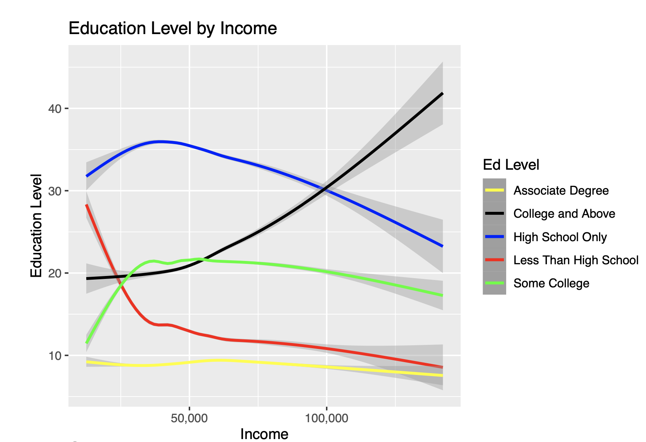
Education Level By Income
Notes:
Percentages:
Less than hs: 12
HS only: 27
Some College: 20
Associate:9
Degree: 32

Slide 8
Determining strength of correlation
By using a linear regression model, I calculated a correlation coefficient for income as it relates to each level of education
Positive correlation indicates that as income goes up, percent of population in that group also goes up
Negative correlation indicates that as income goes up, percent of population in that group goes down
The larger the number (positive or negative) the stronger the correlation

Slide 9
Strength of correlation
Correlation based on 10,000 change in income
Less than High School: -0.76760
High School Only: -0.7578
Some College: 0.04101
Associates Degree: 0.06095
College Degree and Above: 1.42348

Slide 10
Does Being Rural or Urban change the outcome?
Rural Urban Continuum Code ranks counties from 1 to 9 based on population, with 1 being most urban and 9 being most rural
Looking specifically at college degree and above, running a regression model against the continuum code, the correlation coefficient = -0.41047 indicating that as counties become more rural, the percentage of college degrees does go down
Adding income to the regression model along with the continuum code, we see that the correlation coefficient for the code goes down slightly to -0.1640 which tells us that counties that are rural and have lower income levels have less college degrees than rural counties with higher median incomes.

Slide 11
Conclusions
There does appear to be a correlation between income and educational attainment
The correlation is strongest for college degree and above
There is very little correlation for some college or associates degree
$100,000 is a level that we clearly see a cross between high school diploma only and college degree and above
There is a slight correlation between educational attainment and urban vs. rural setting, however, the correlation appears to strengthened by differences in income

